Slide 1

Welcome all NECASI members
Dr Jayanta Kumar Das
Secretary, NECASI
2022-23

Slide 2
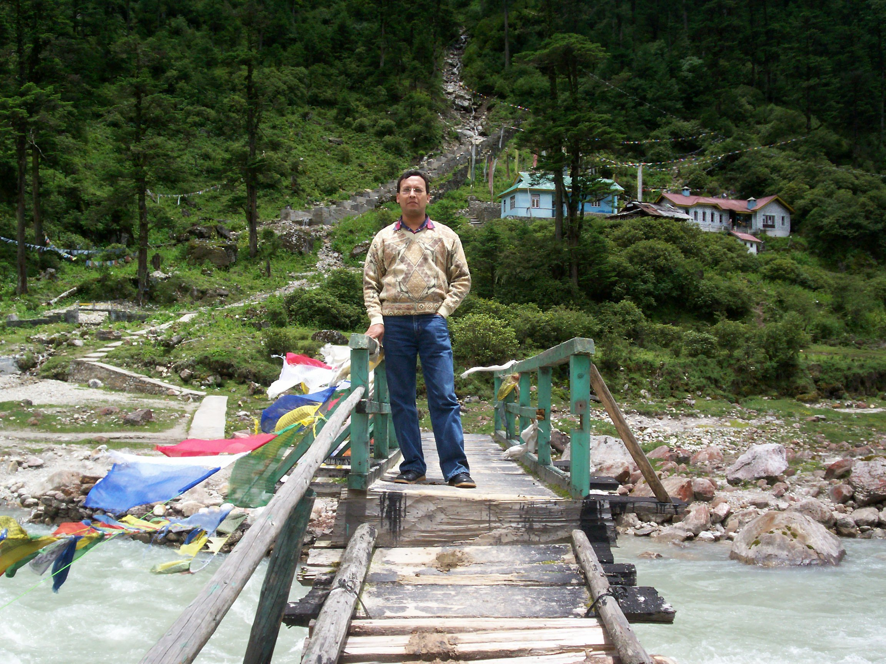
6th July, 2007……

Slide 3
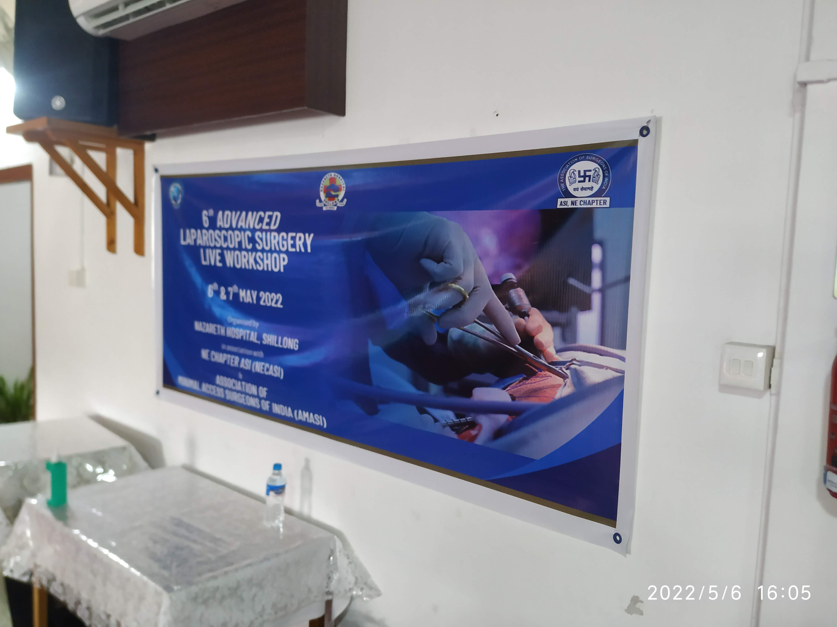
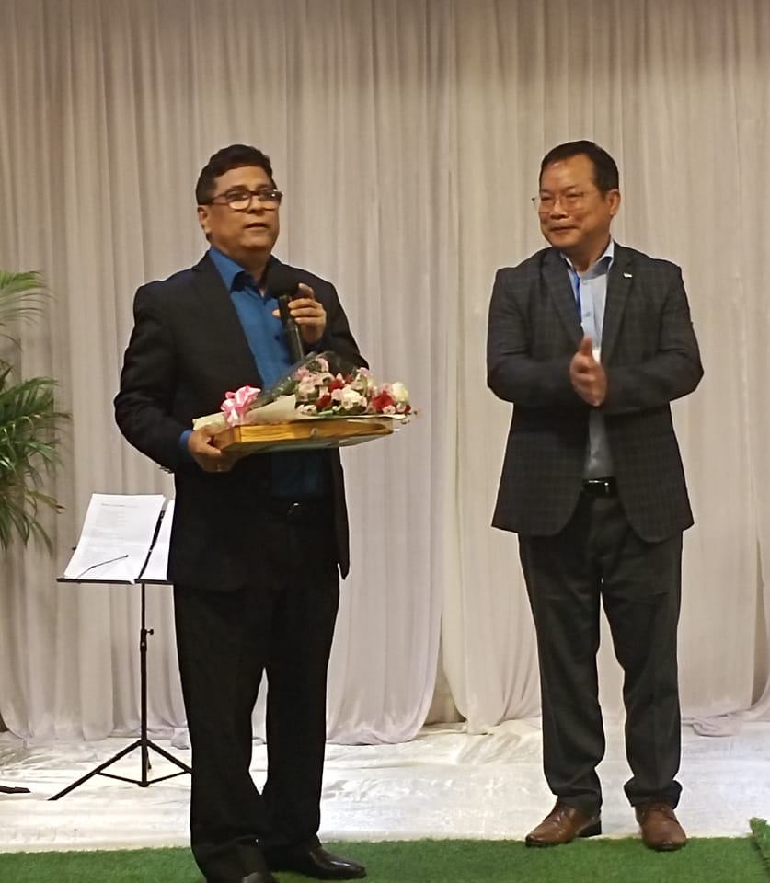
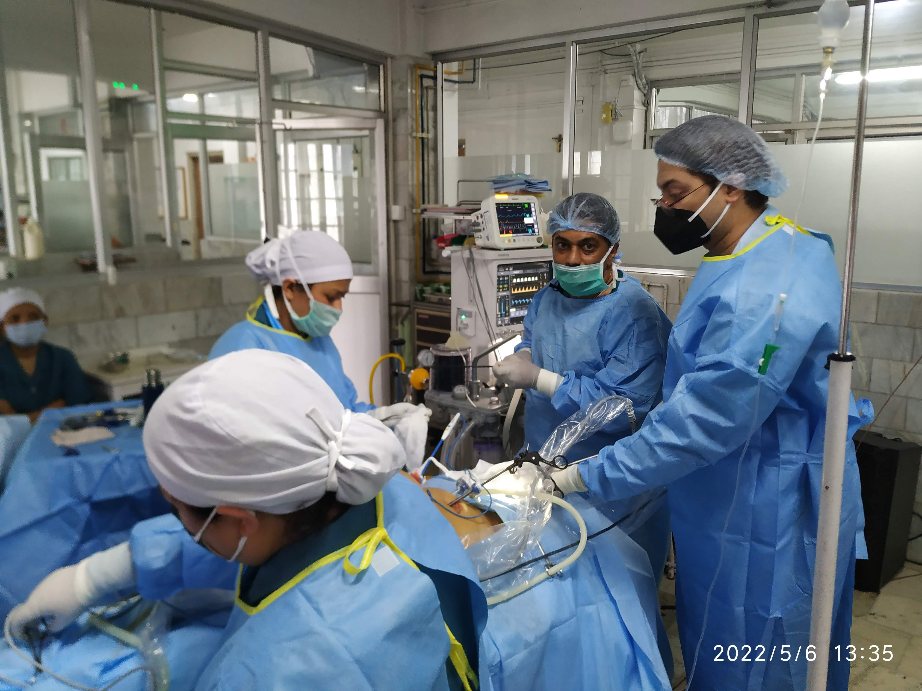
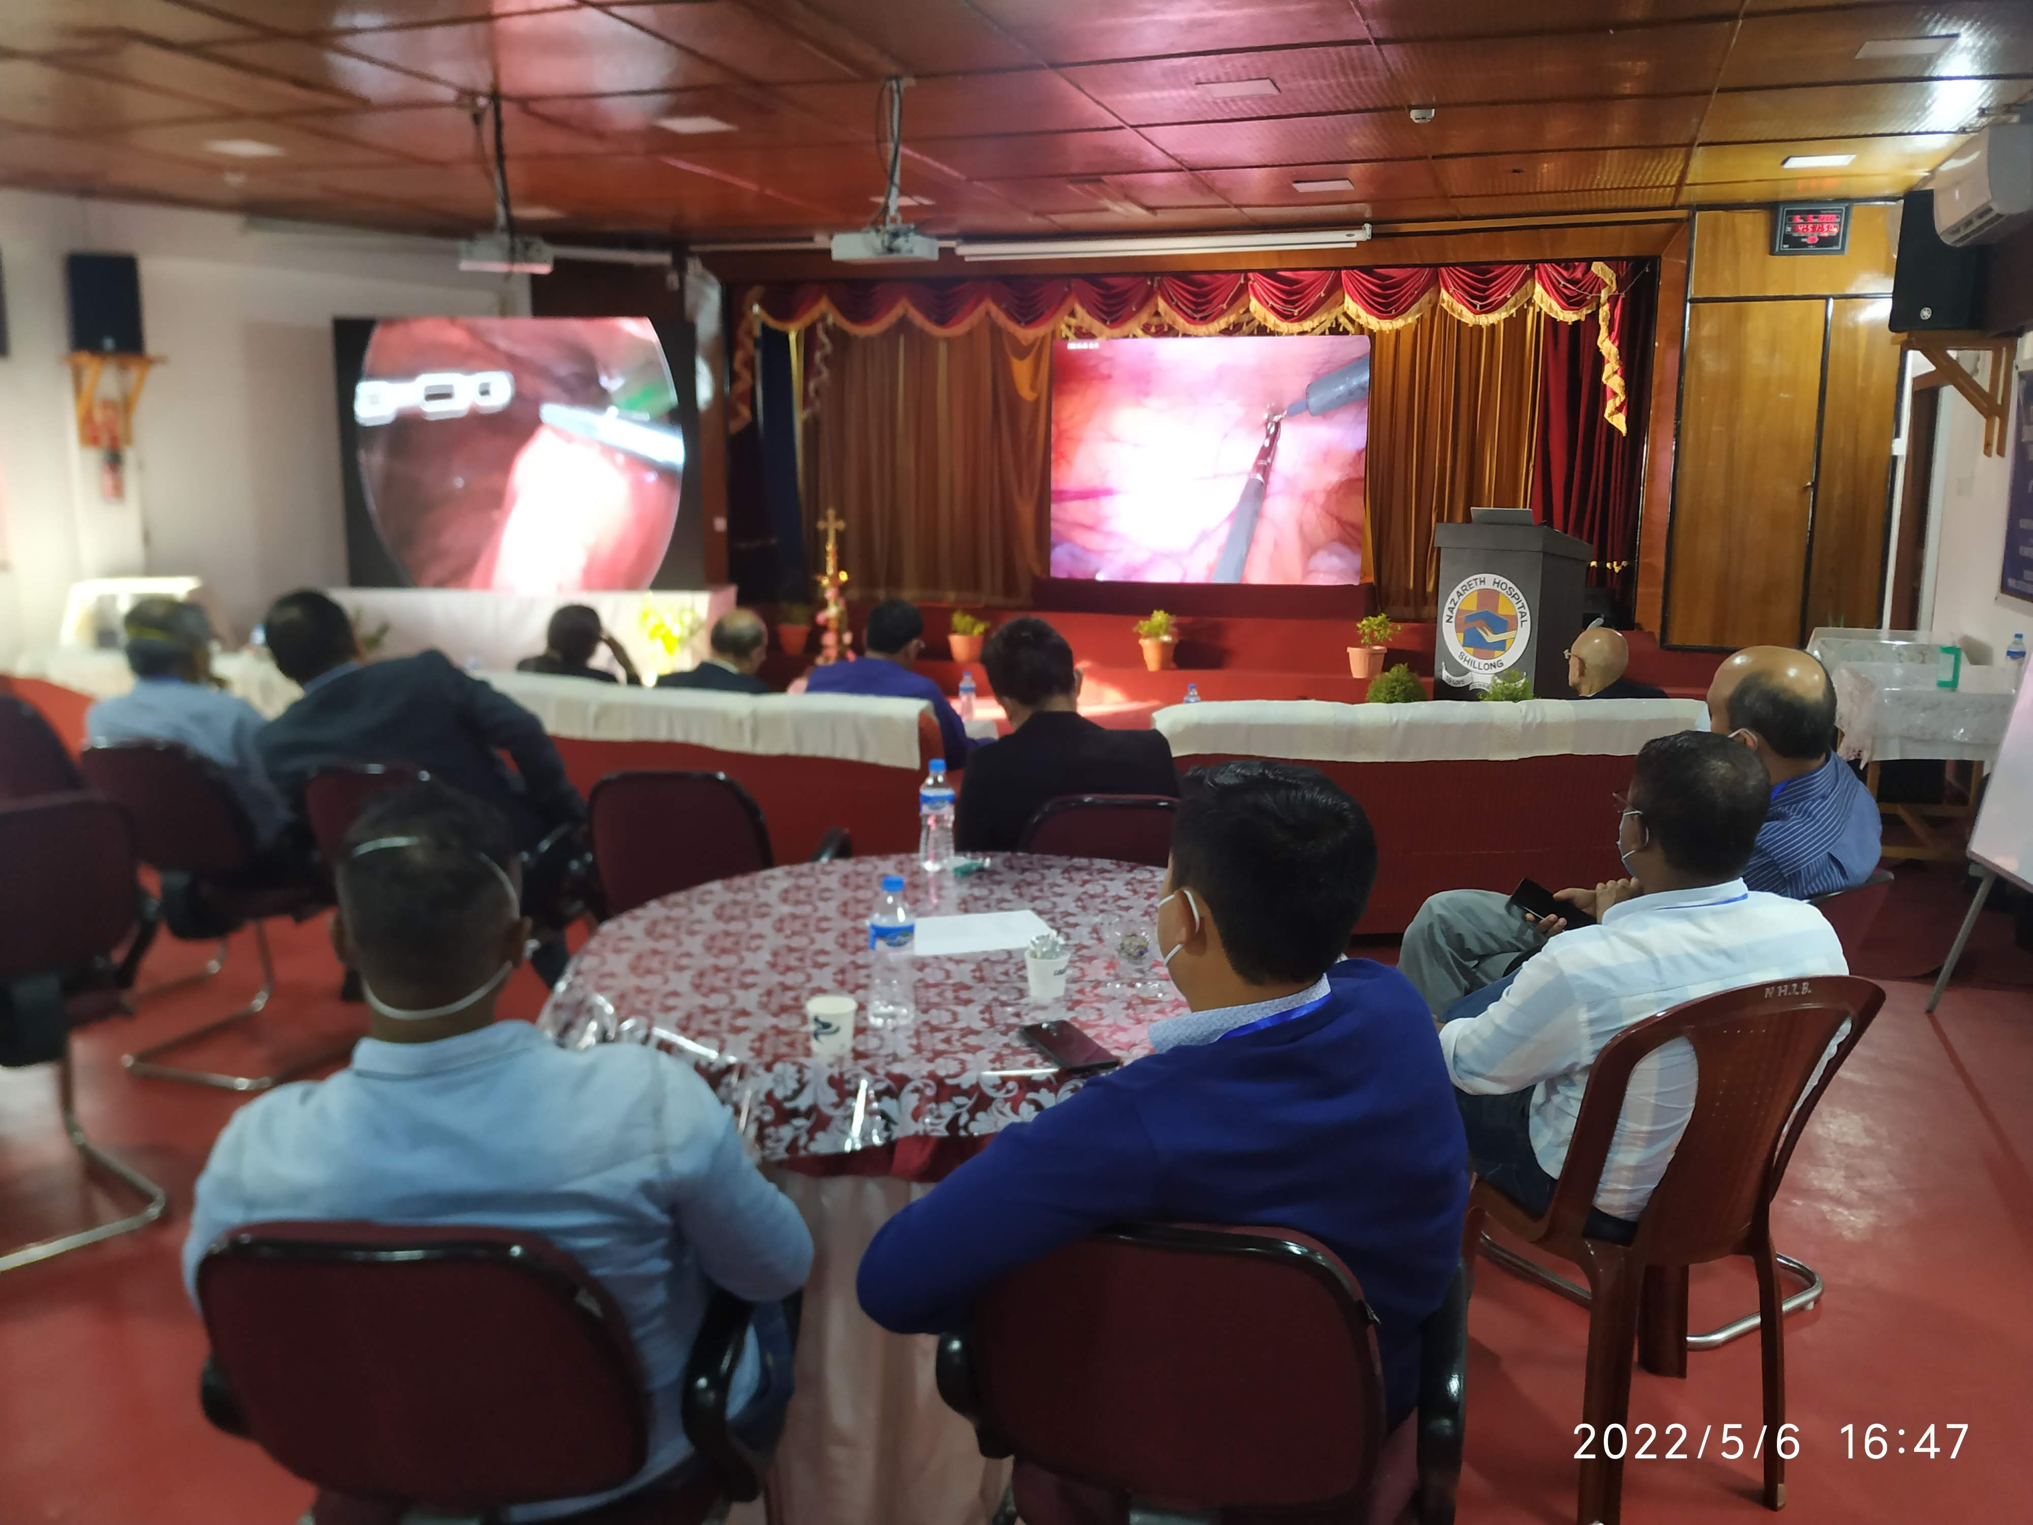
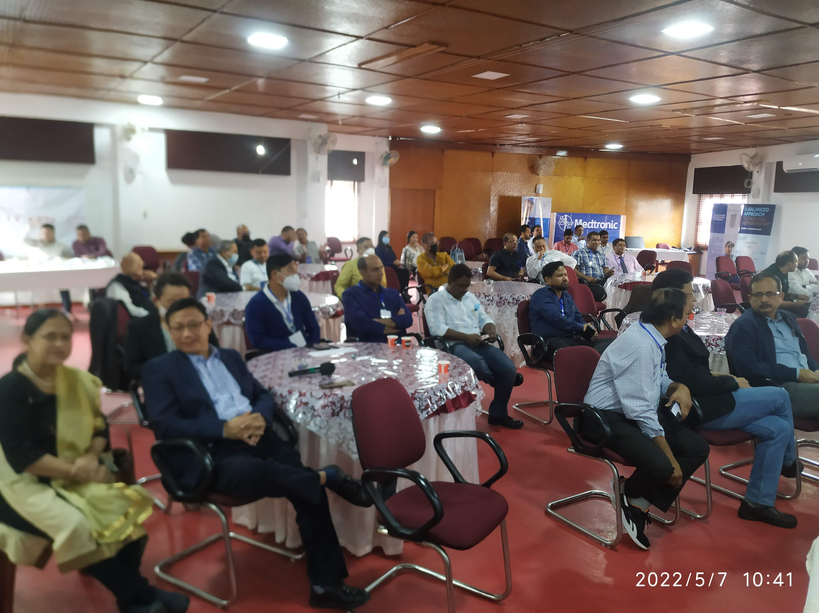
6TH Advanced Live Lap. Surgery Workshop Shillong, Meghalaya (5th -6th July)
A total of 14 Advances live laparoscopic surgeries were transmitted on two LED screens

Slide 4
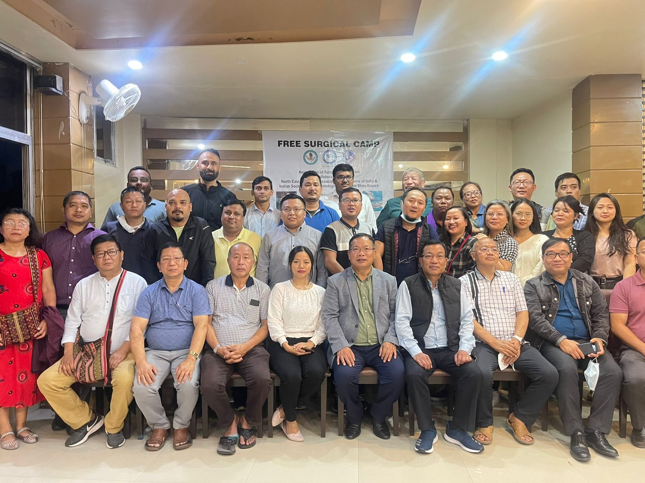
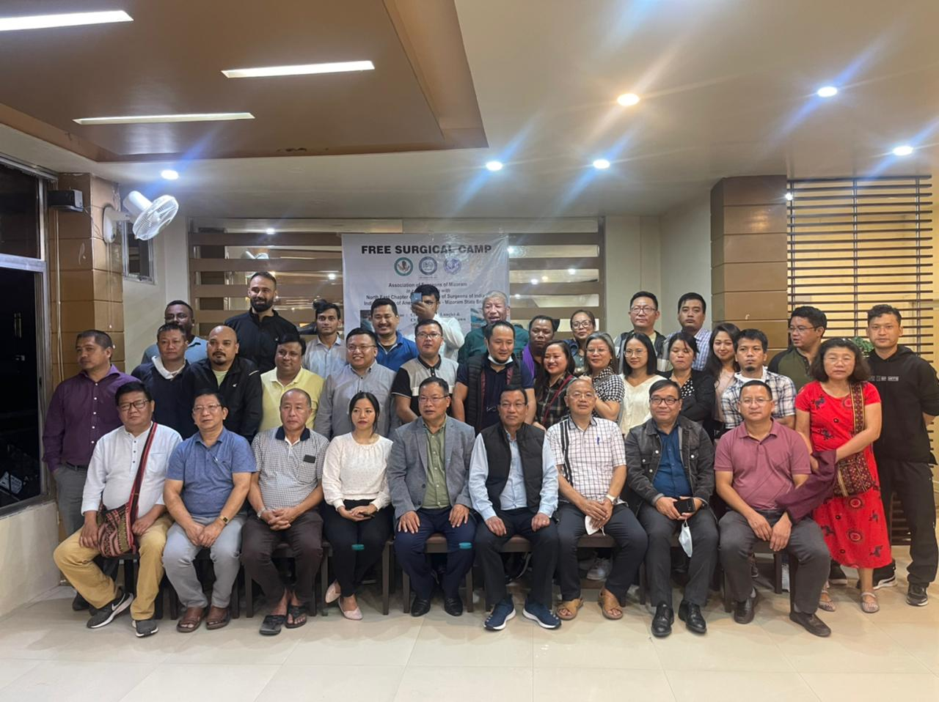
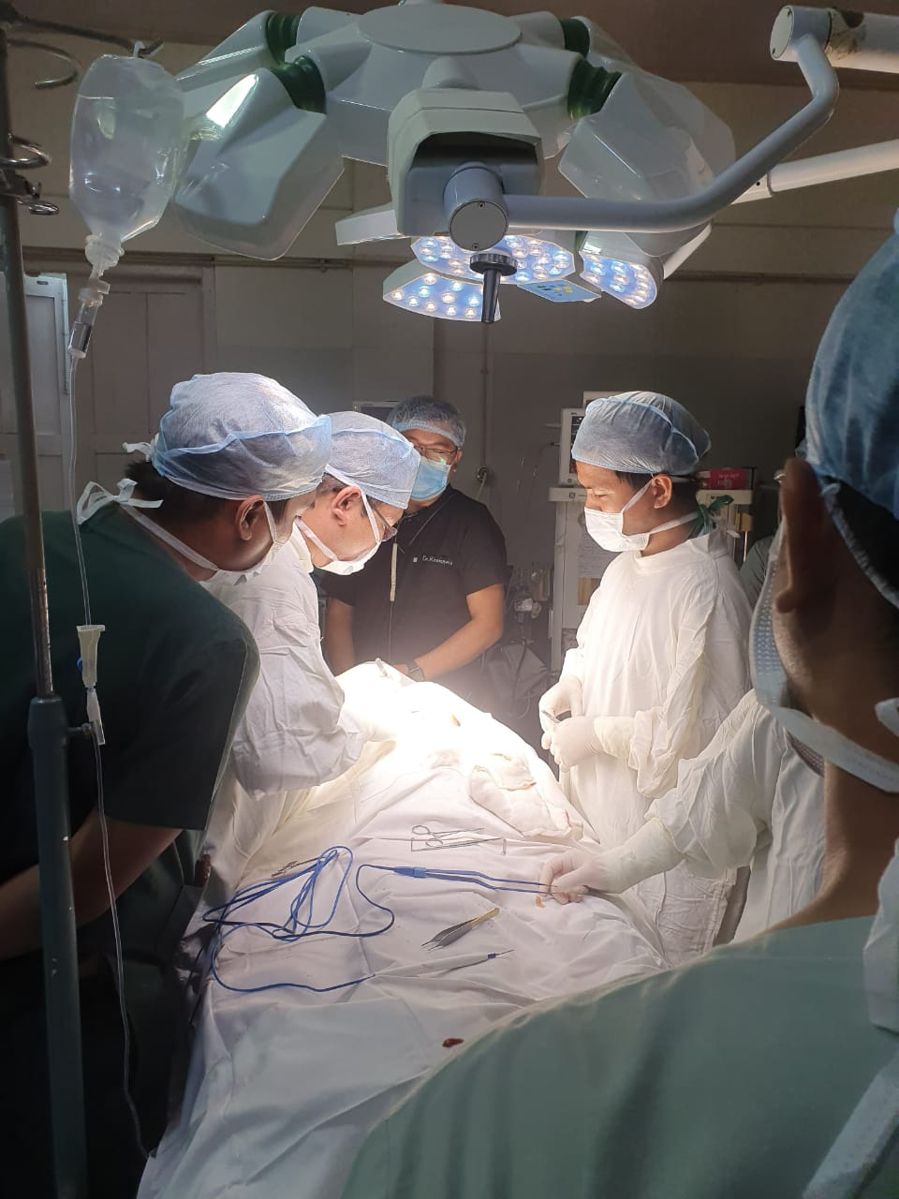
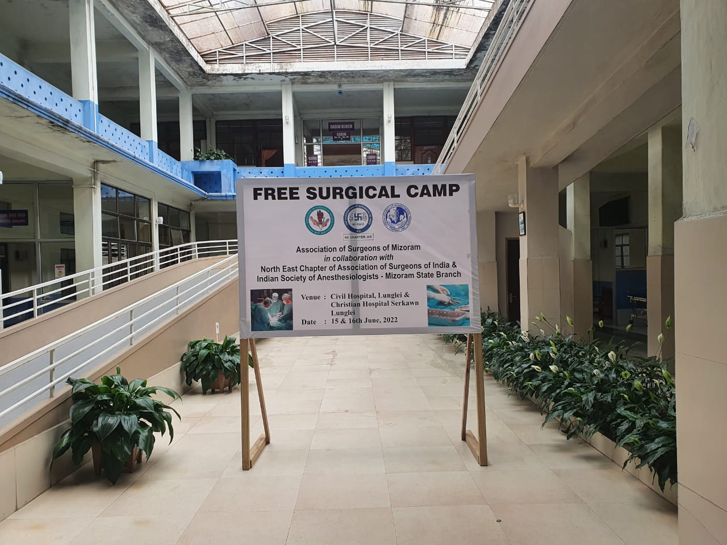
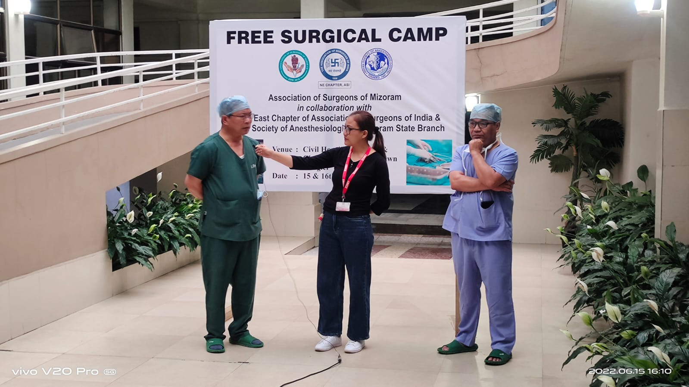
Free surgical camp
Lunglei, Mizoram (15th -16th June)
A total of 22 free surgeries were performed

Slide 5
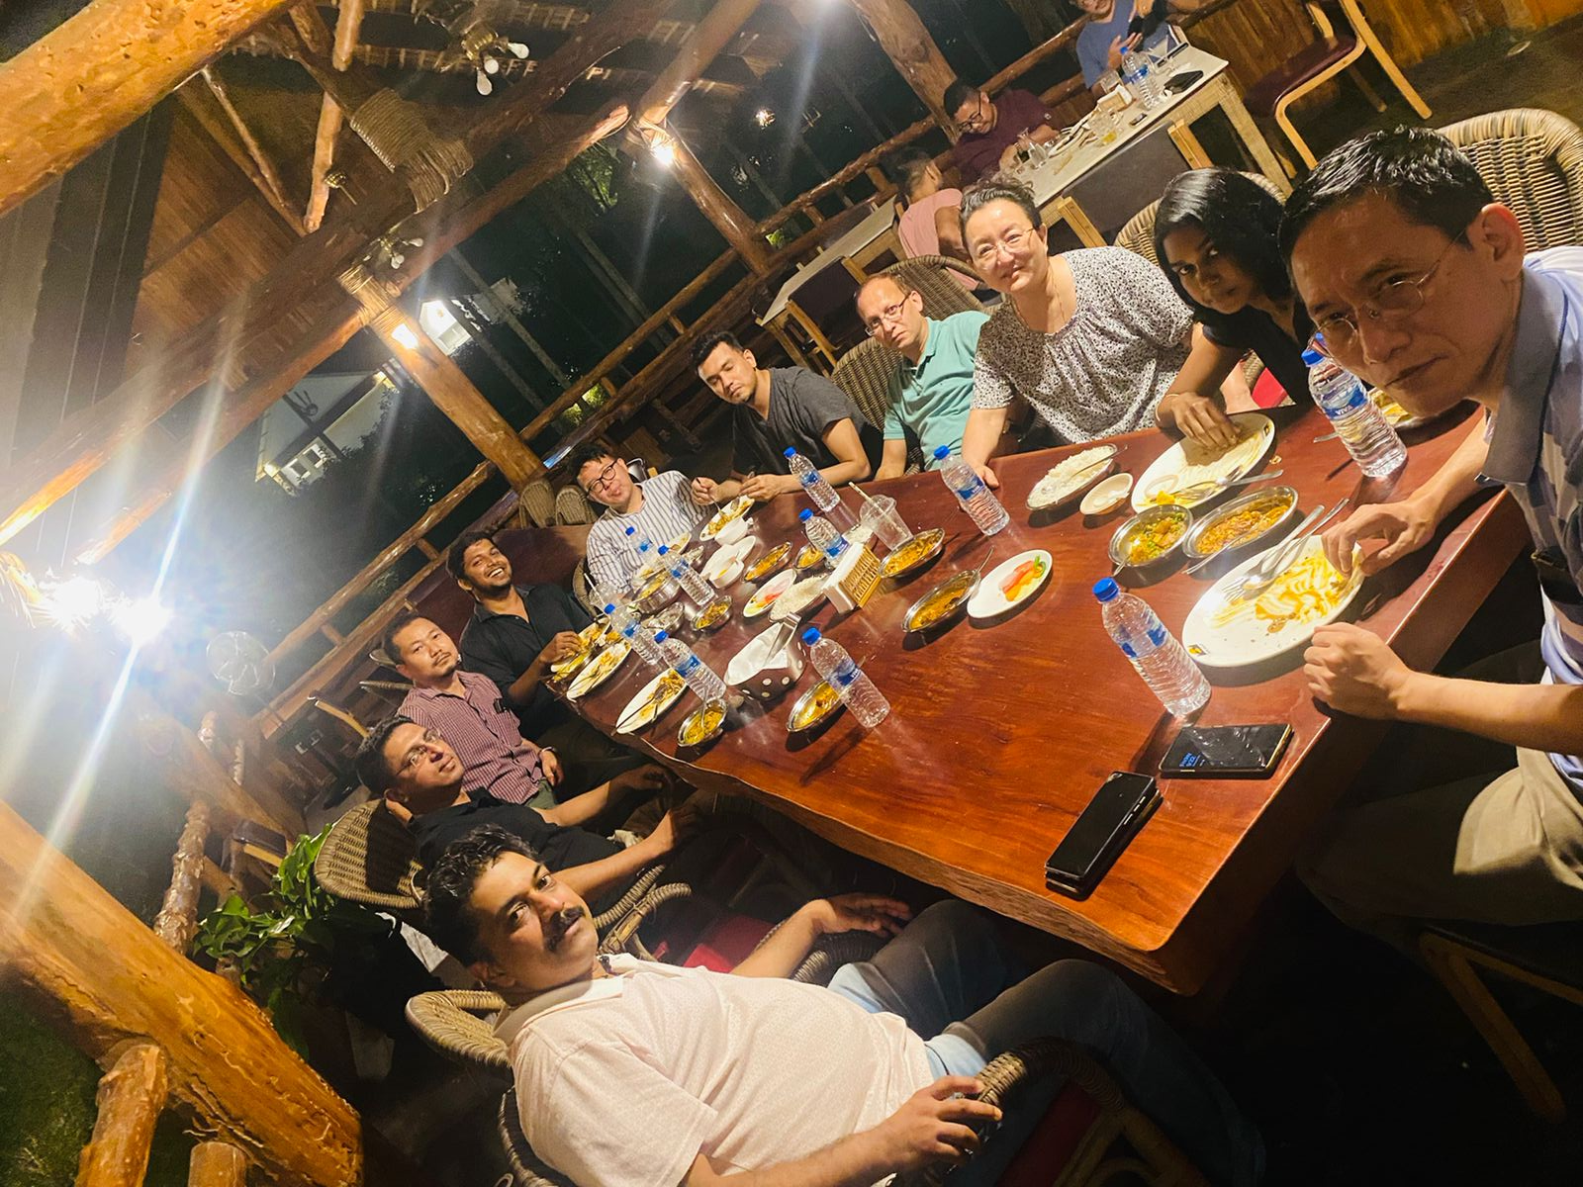
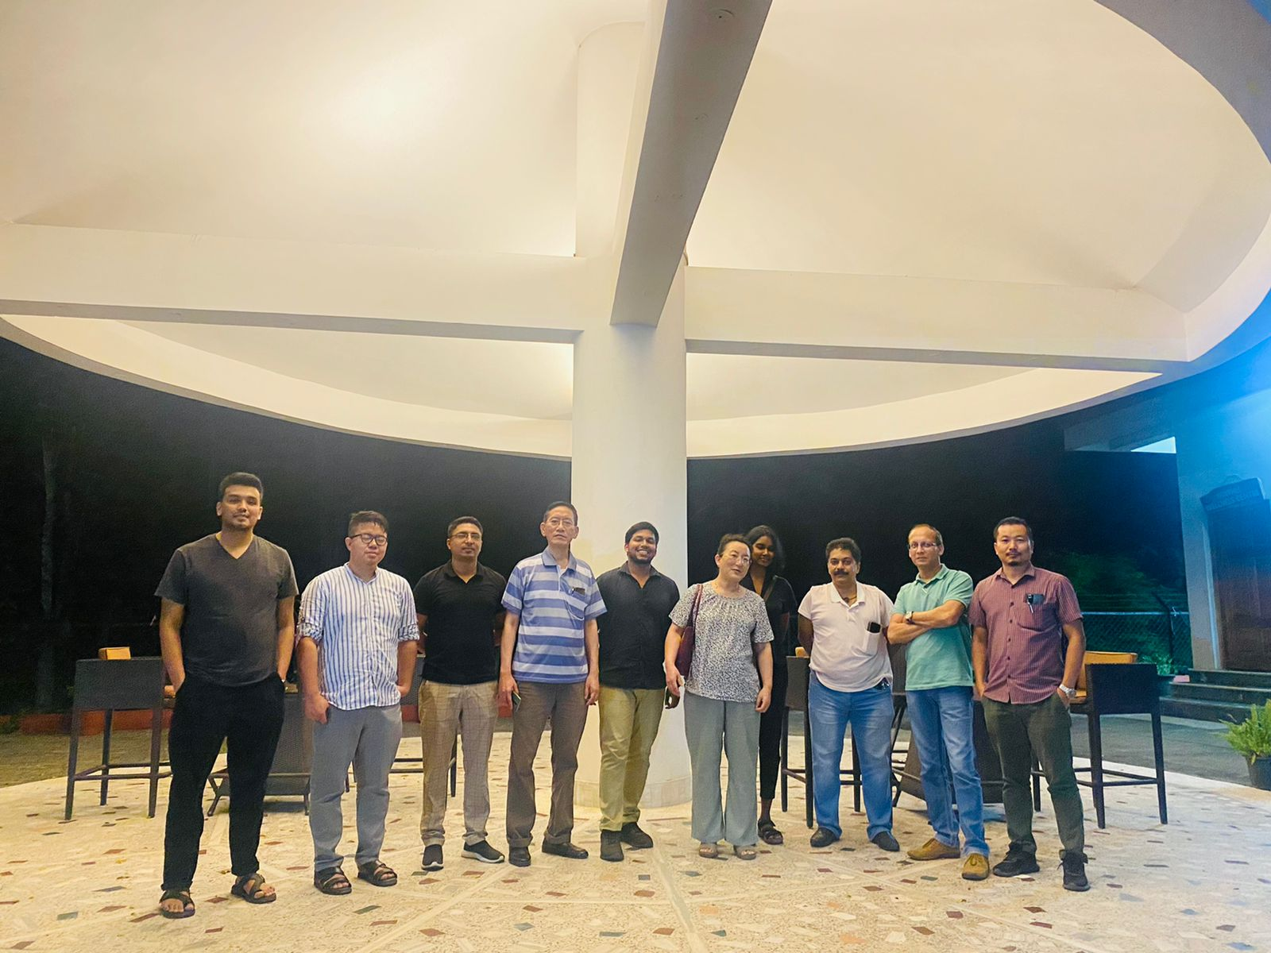
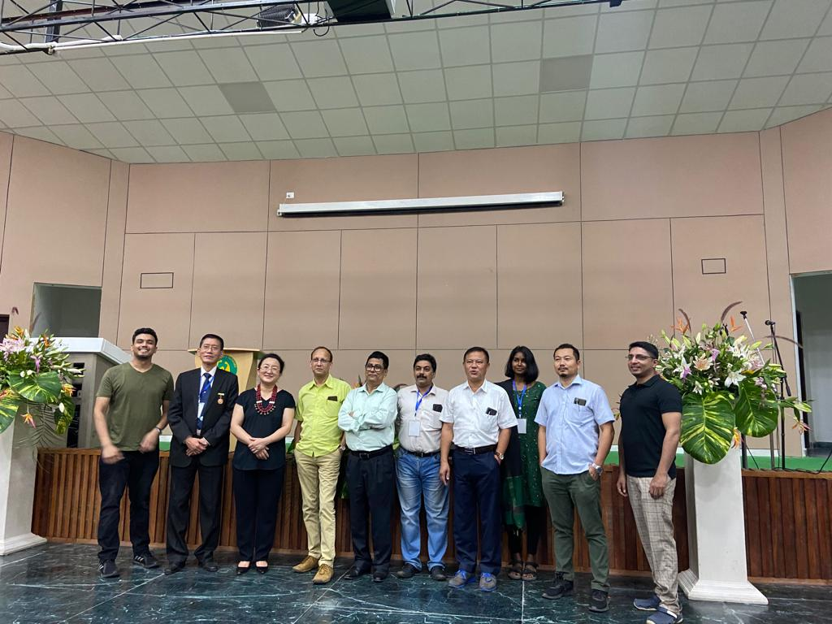
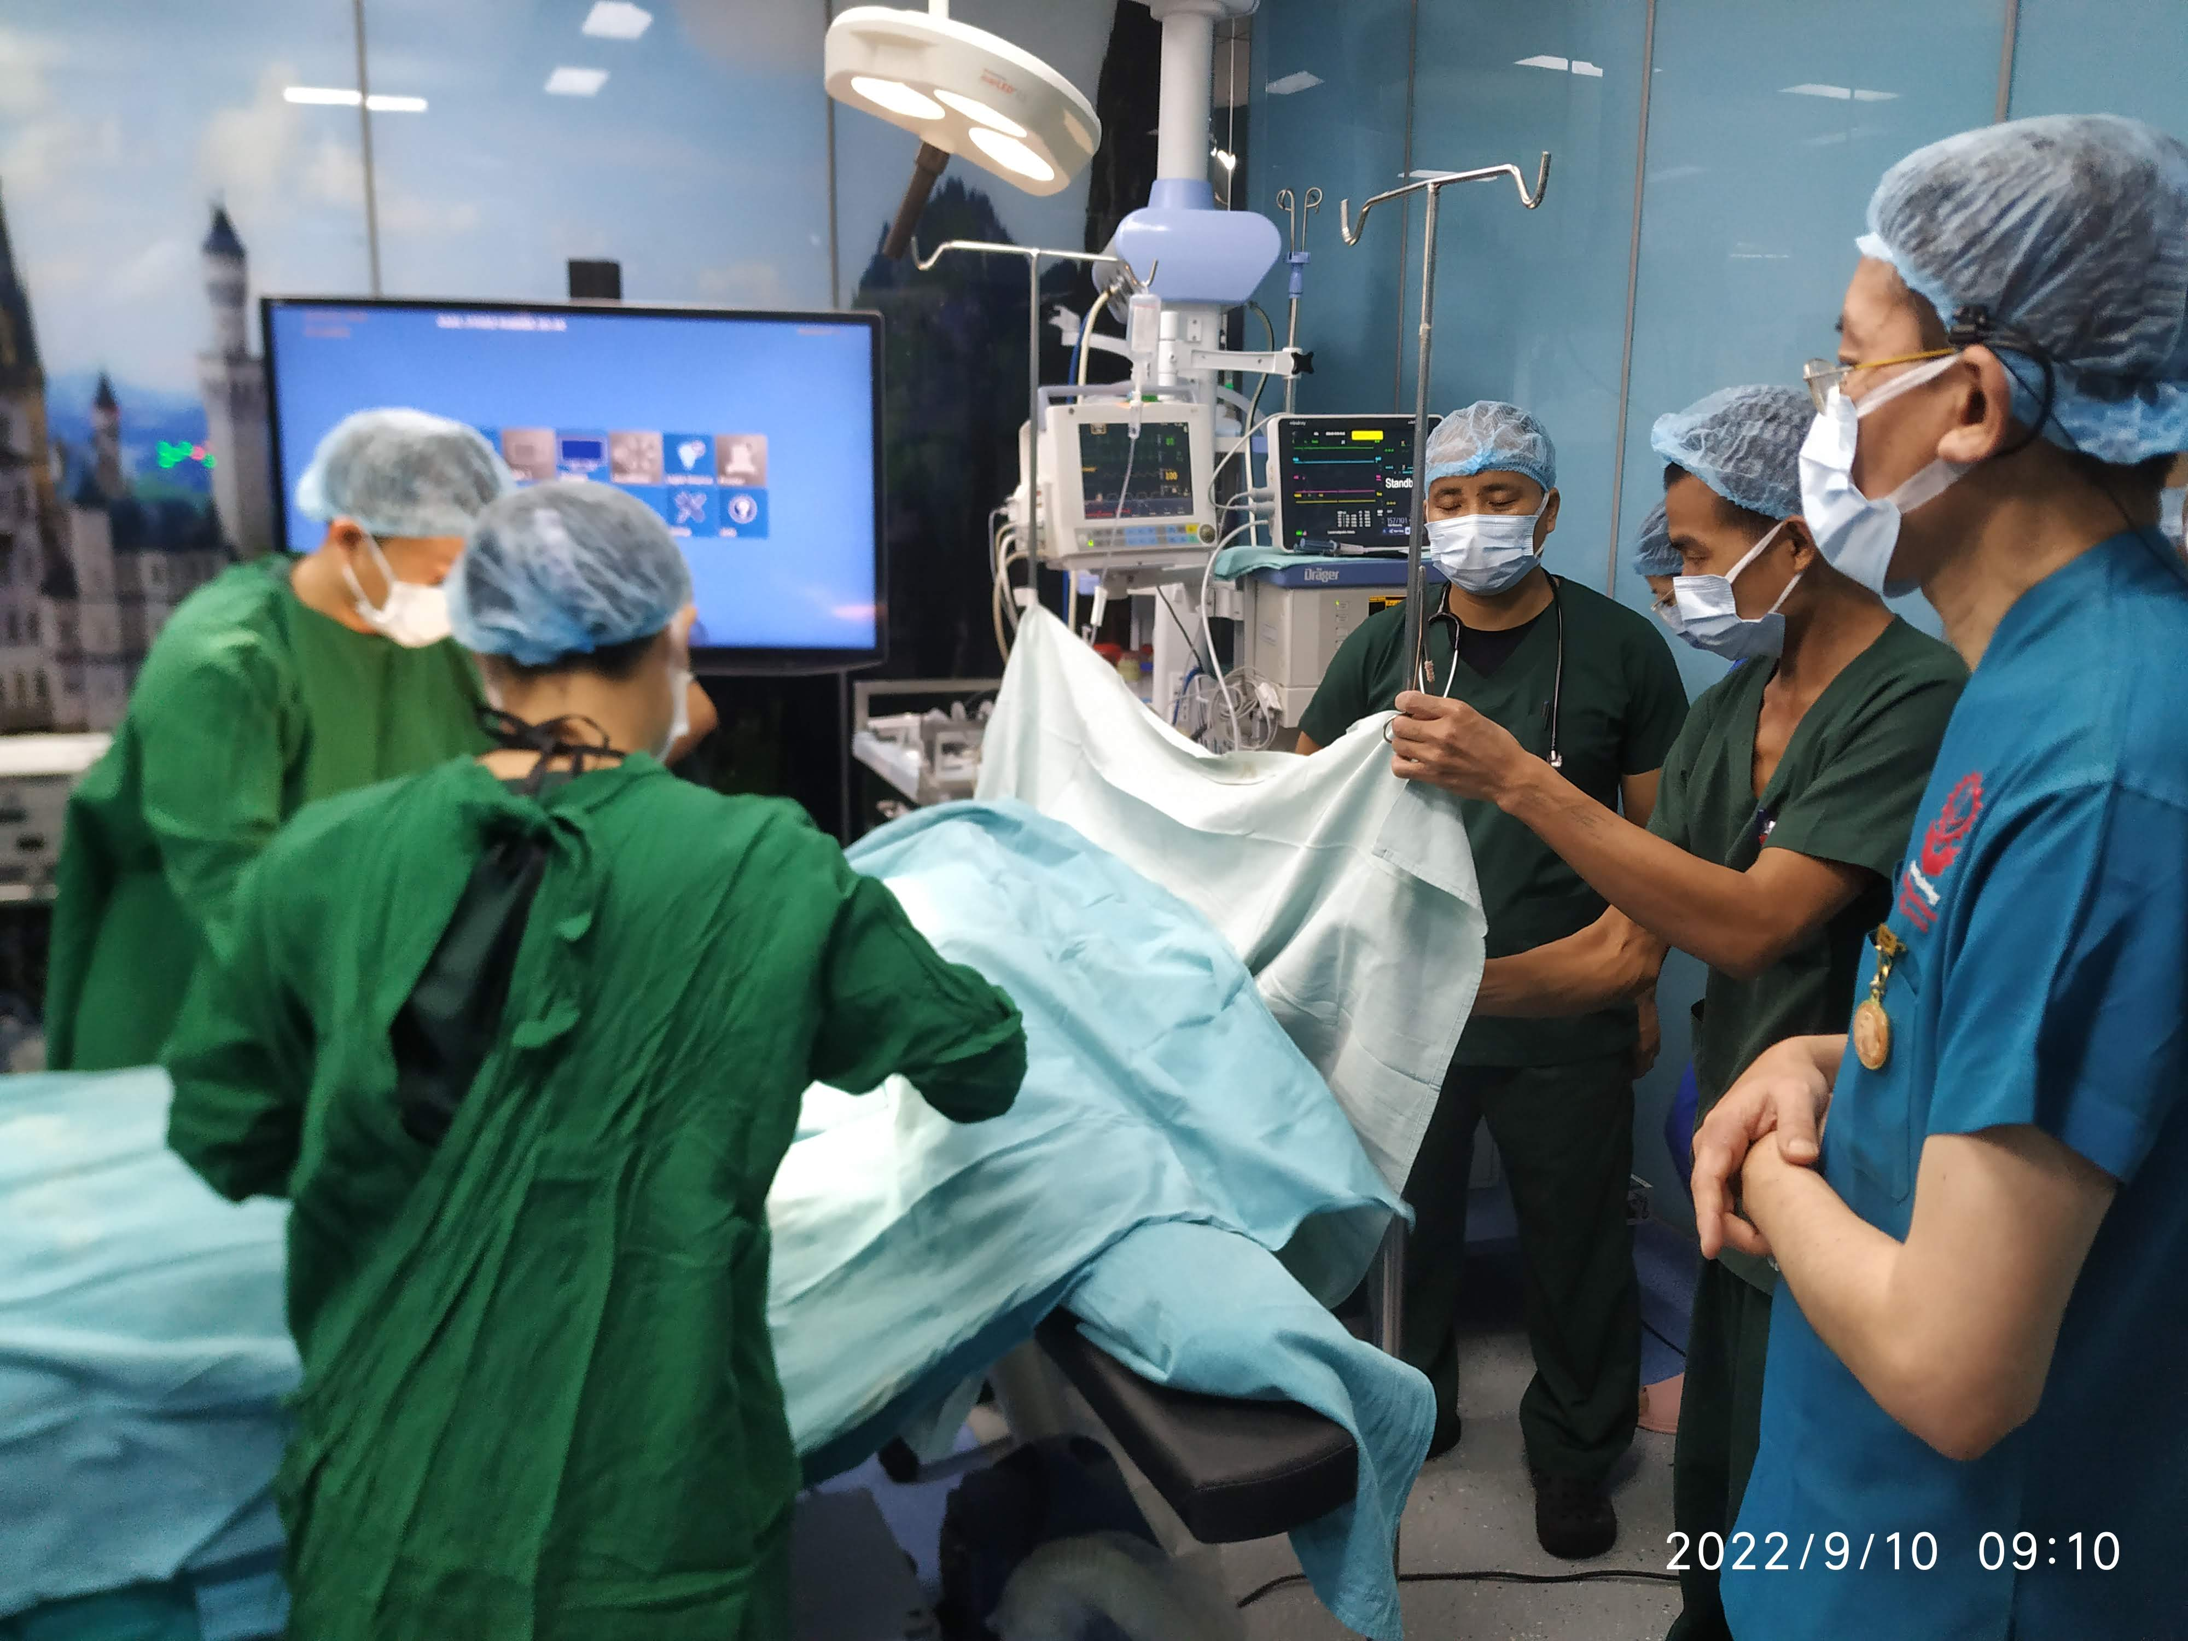
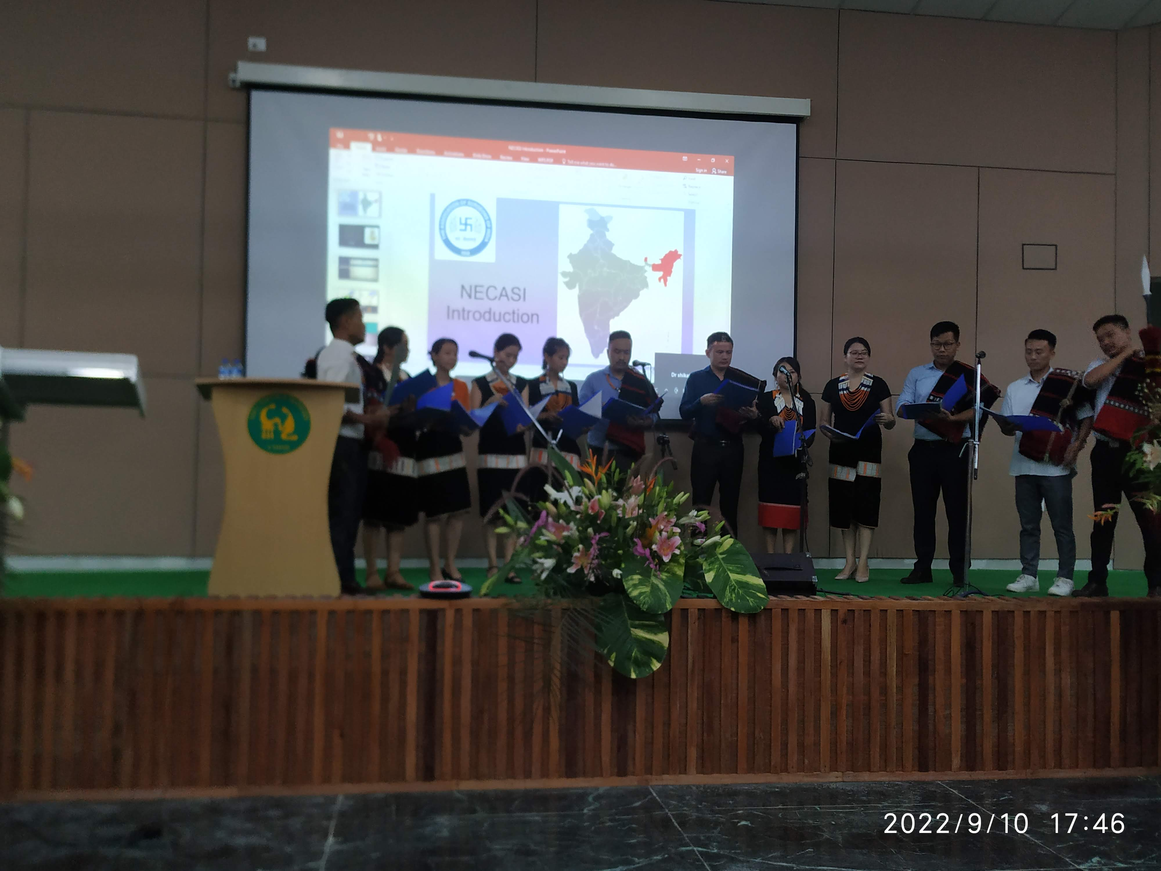
1st Live Lap. Surgery Workshop cum CME
CIHSR, Dimapur, Nagaland (10TH September)
A total of 9 live laparoscopic surgery cases were performed.
It was followed by a CME.

Slide 6
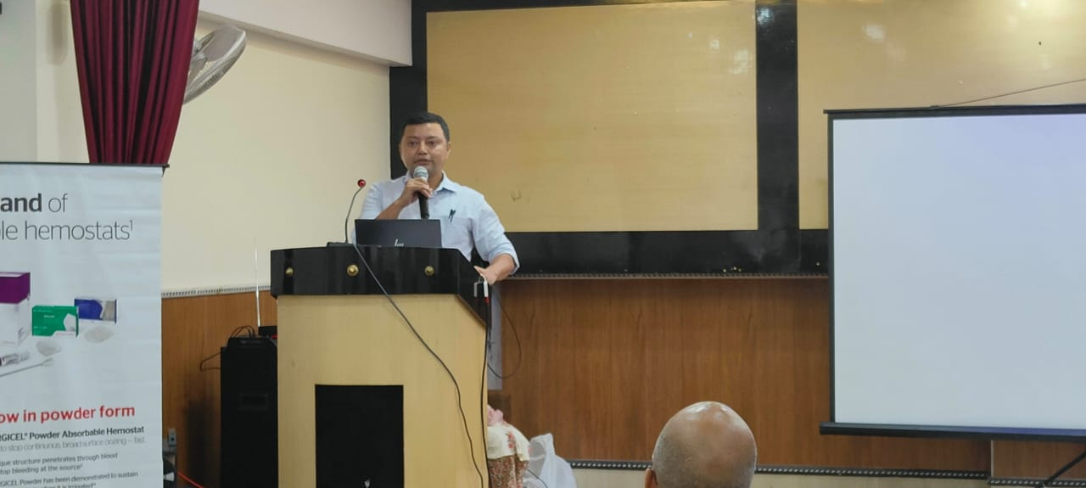
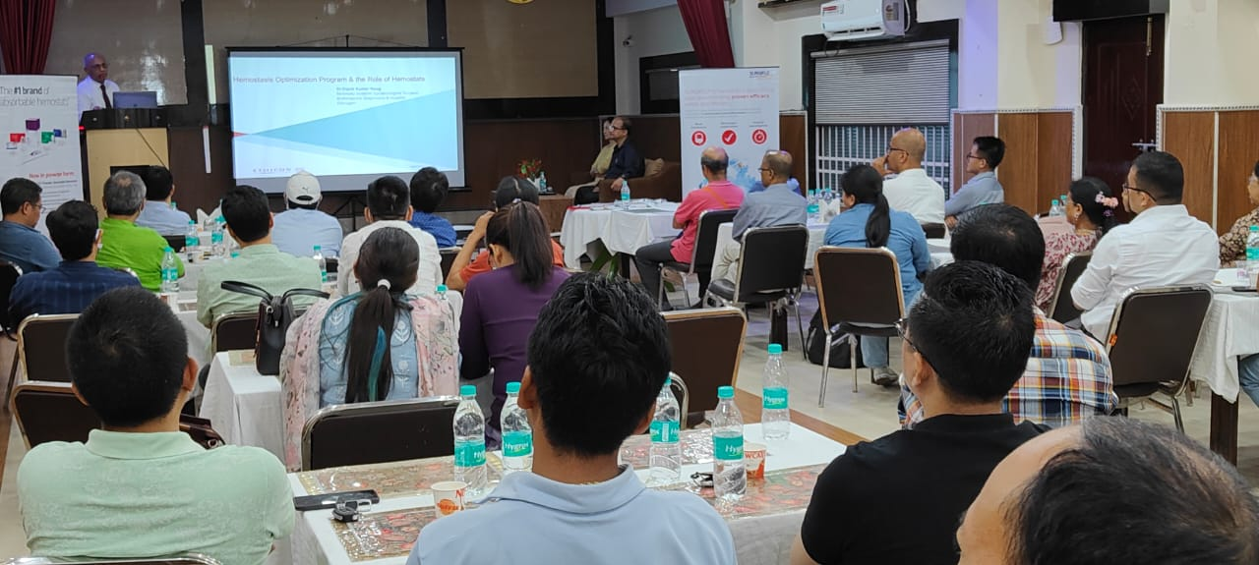
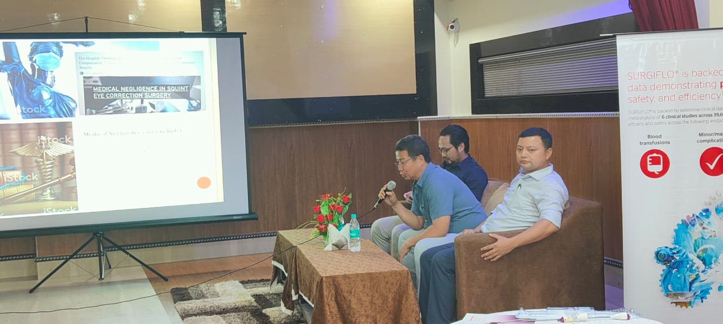
Surgery CME
Naharlagun, Arunachal Pradesh (10th September)

Slide 7
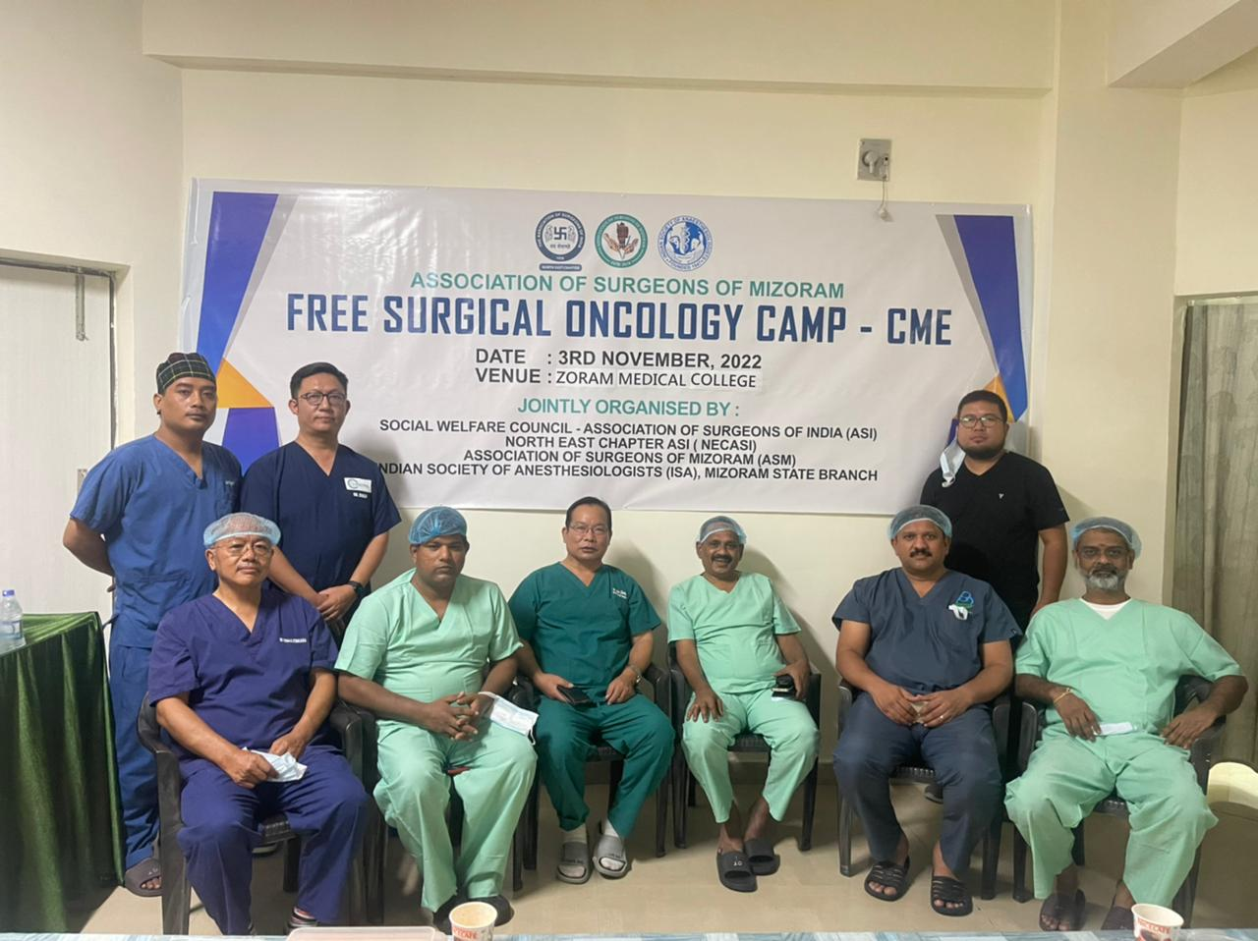
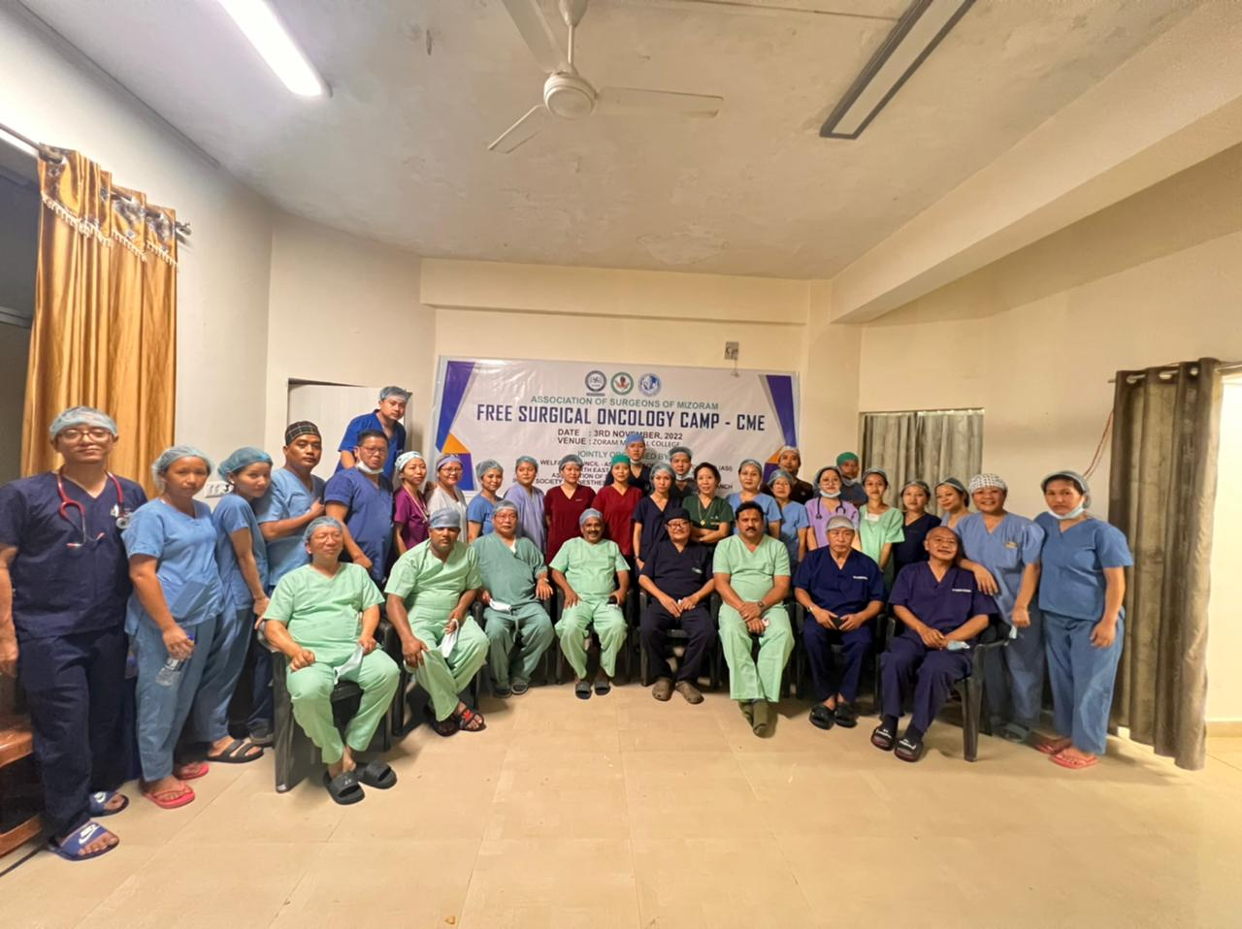
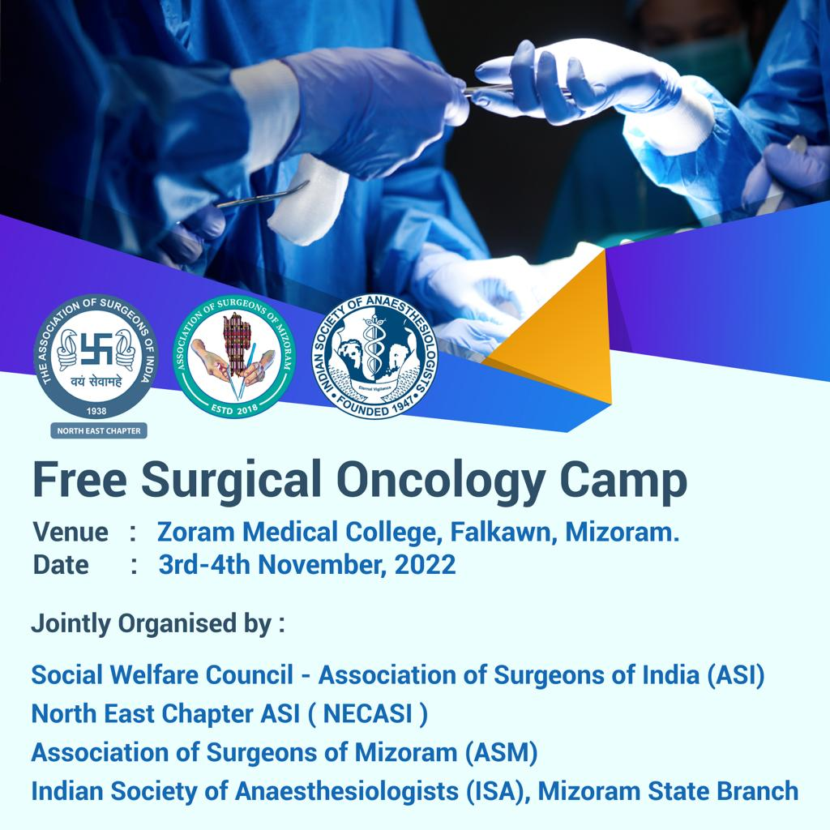
Free Surgical Oncology Camp, Falkawn, Mizoram (03rd November)
A total of 16 operations performed

Slide 8
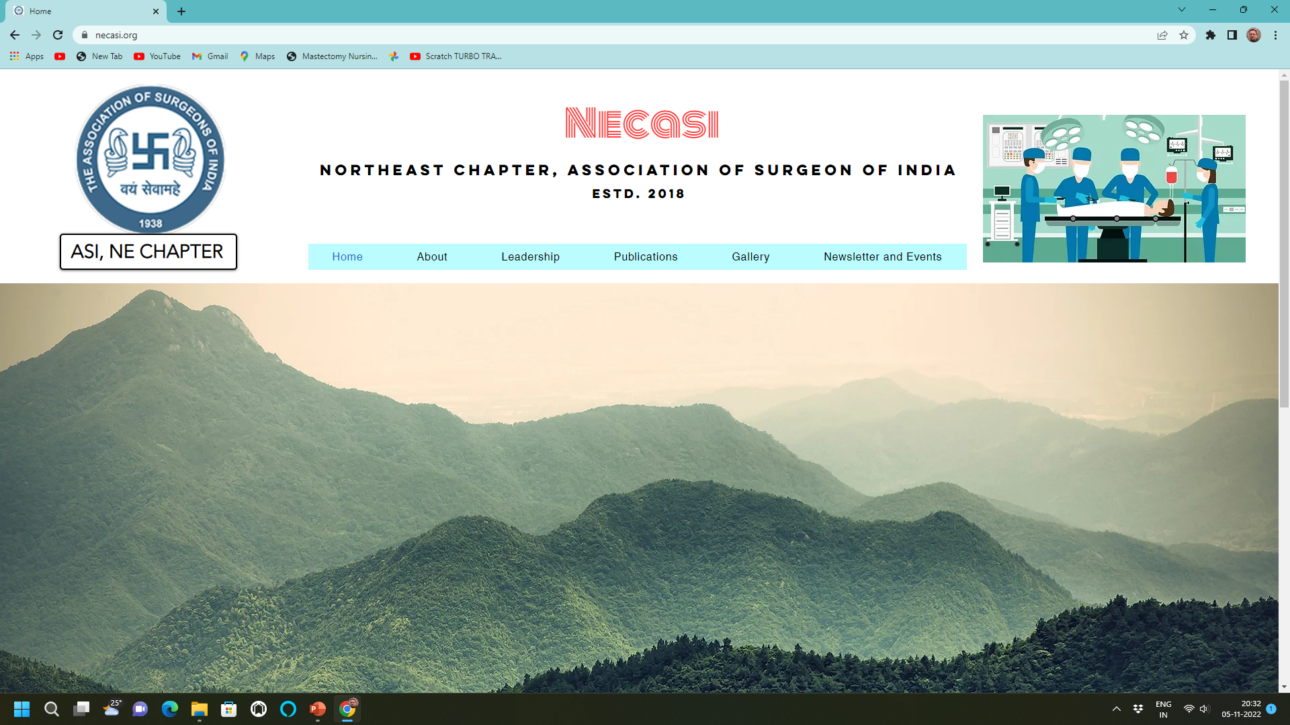
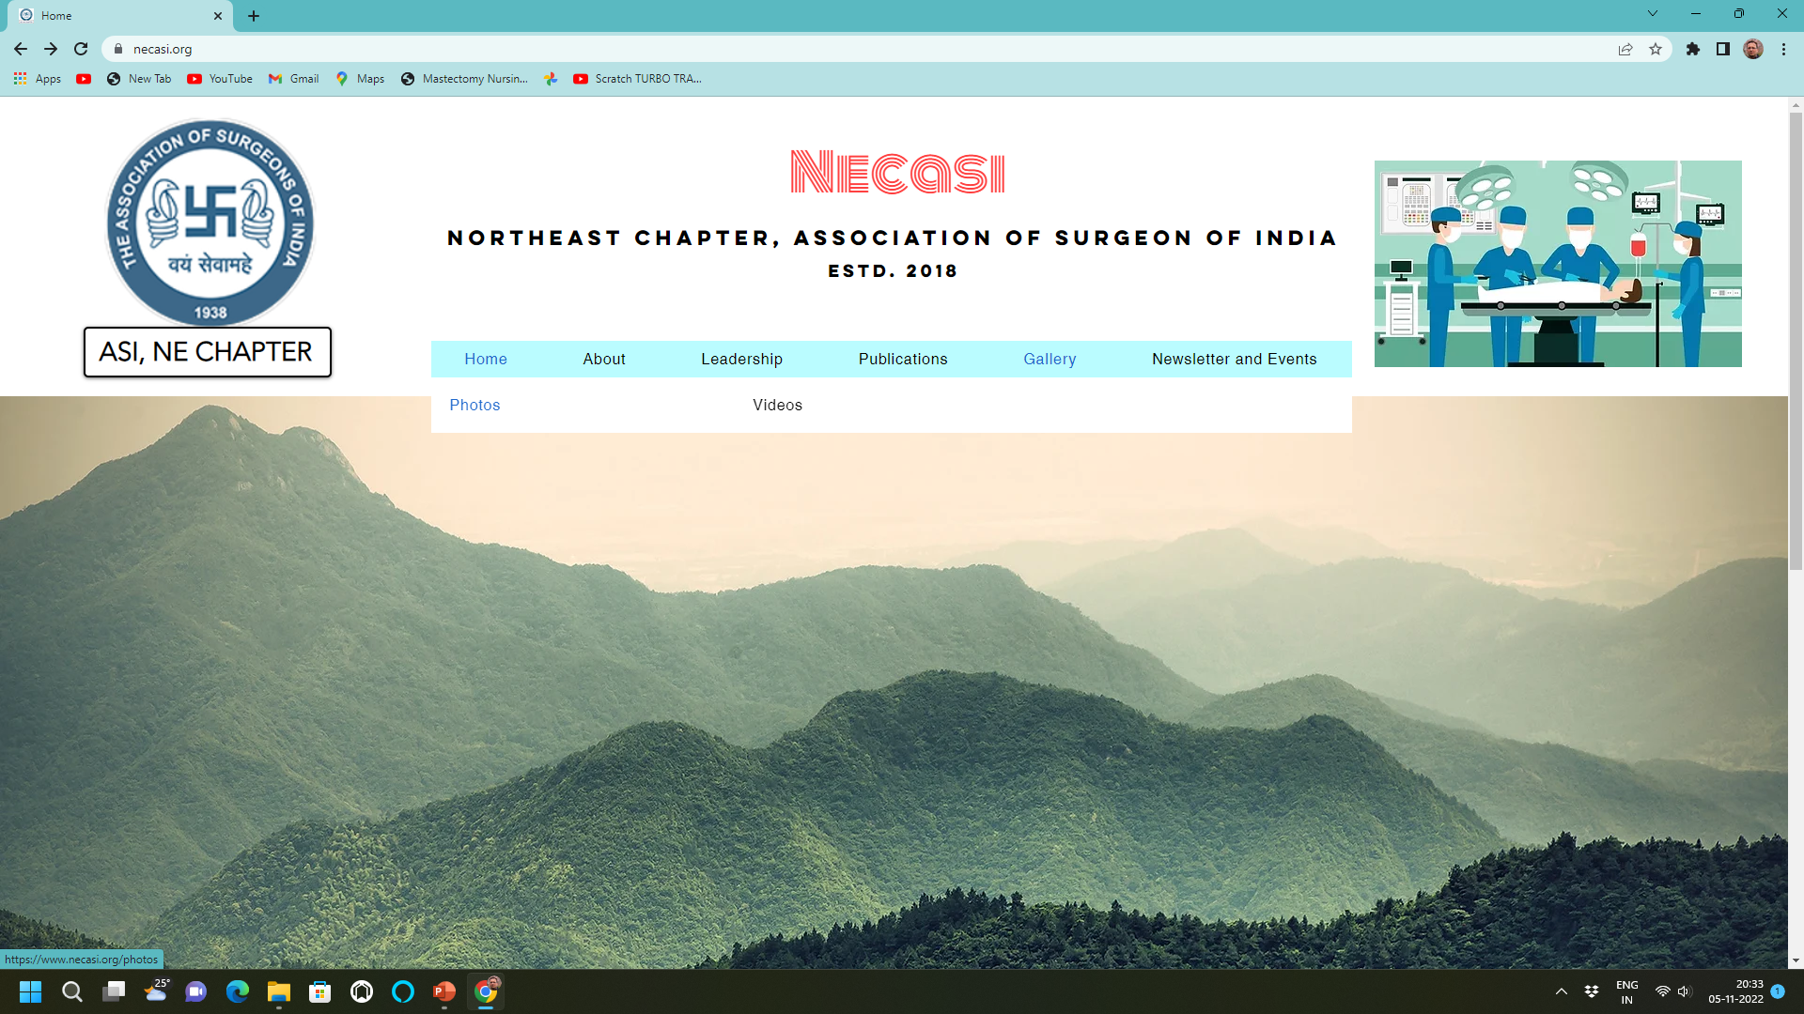
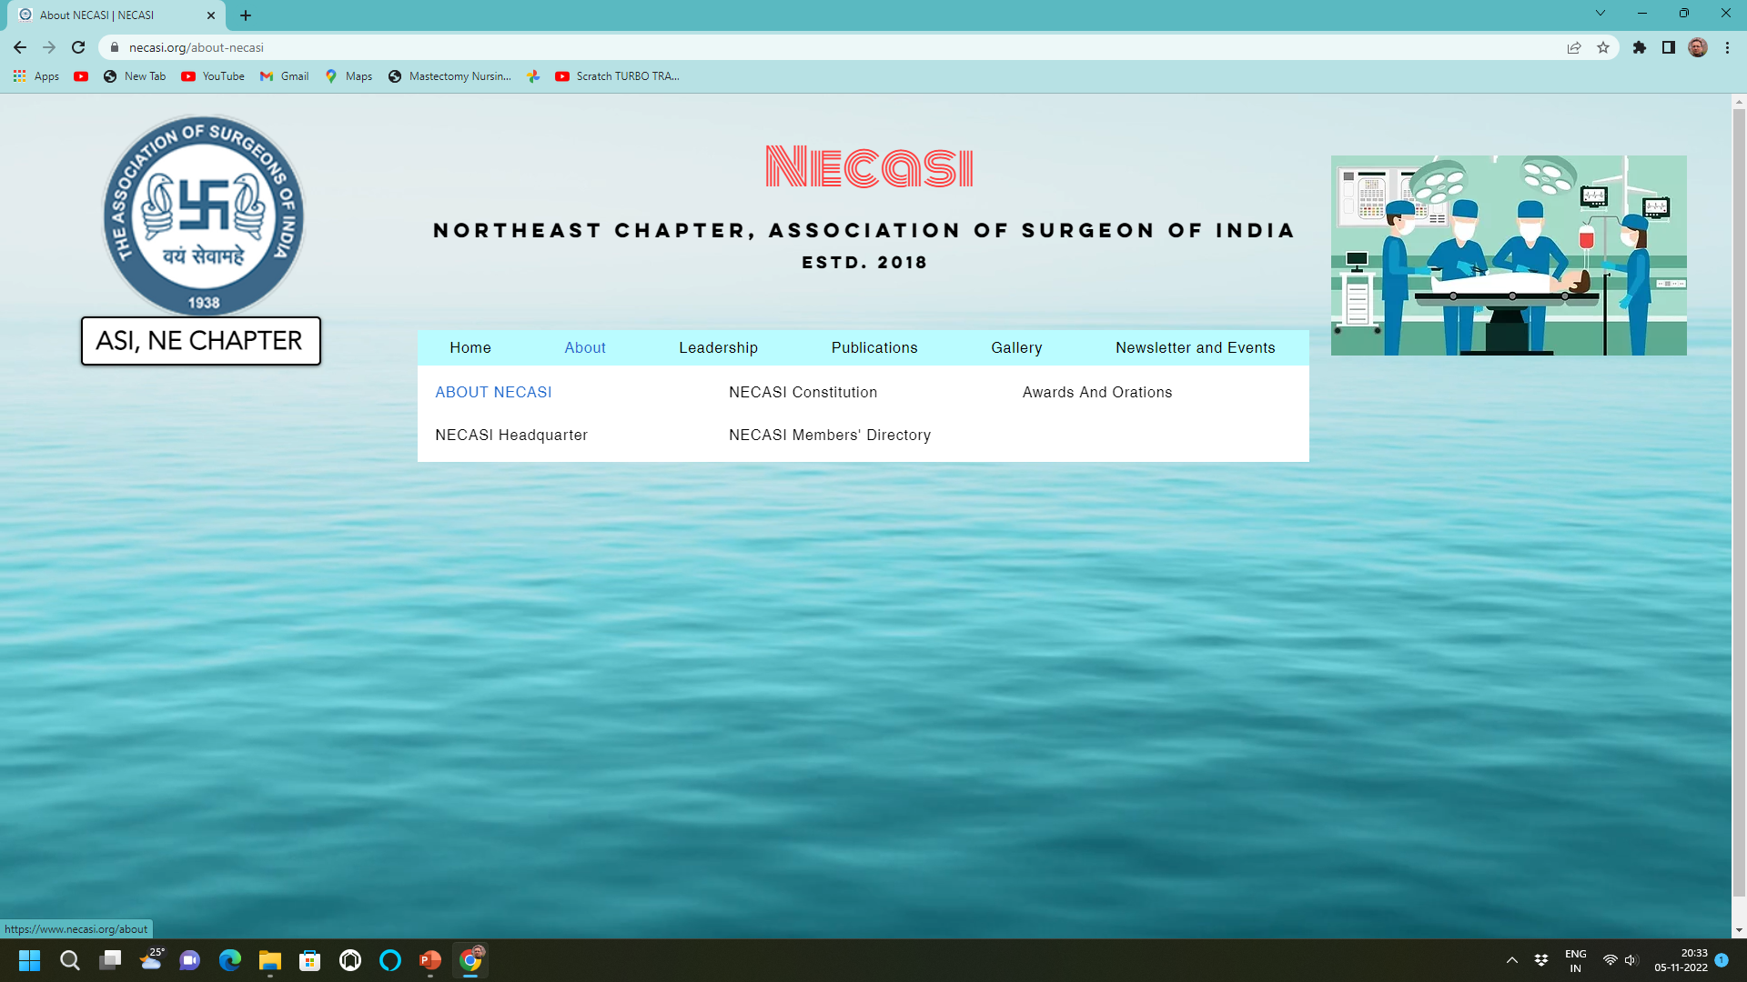
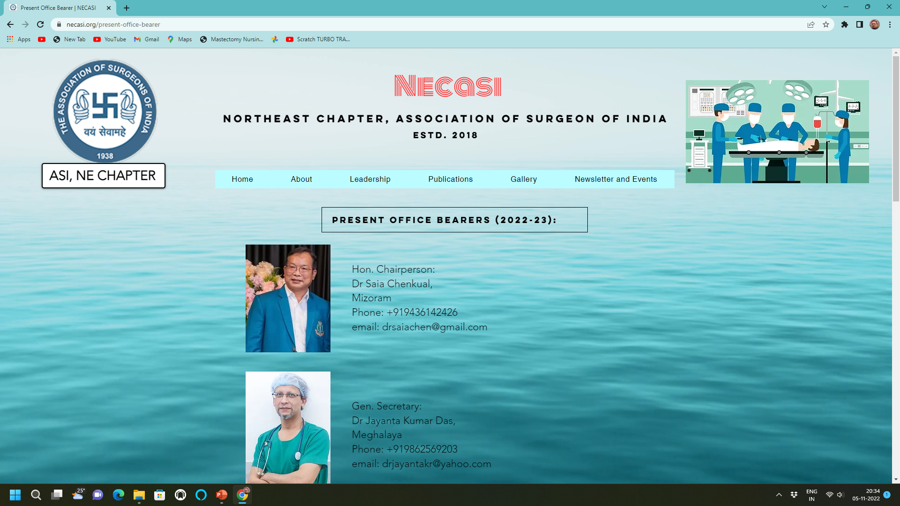
NECASI WEBSITE www.necasi.org

Slide 9
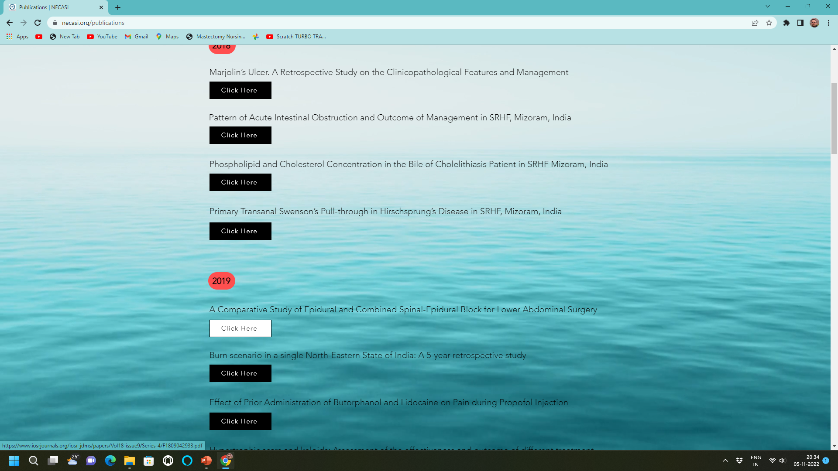
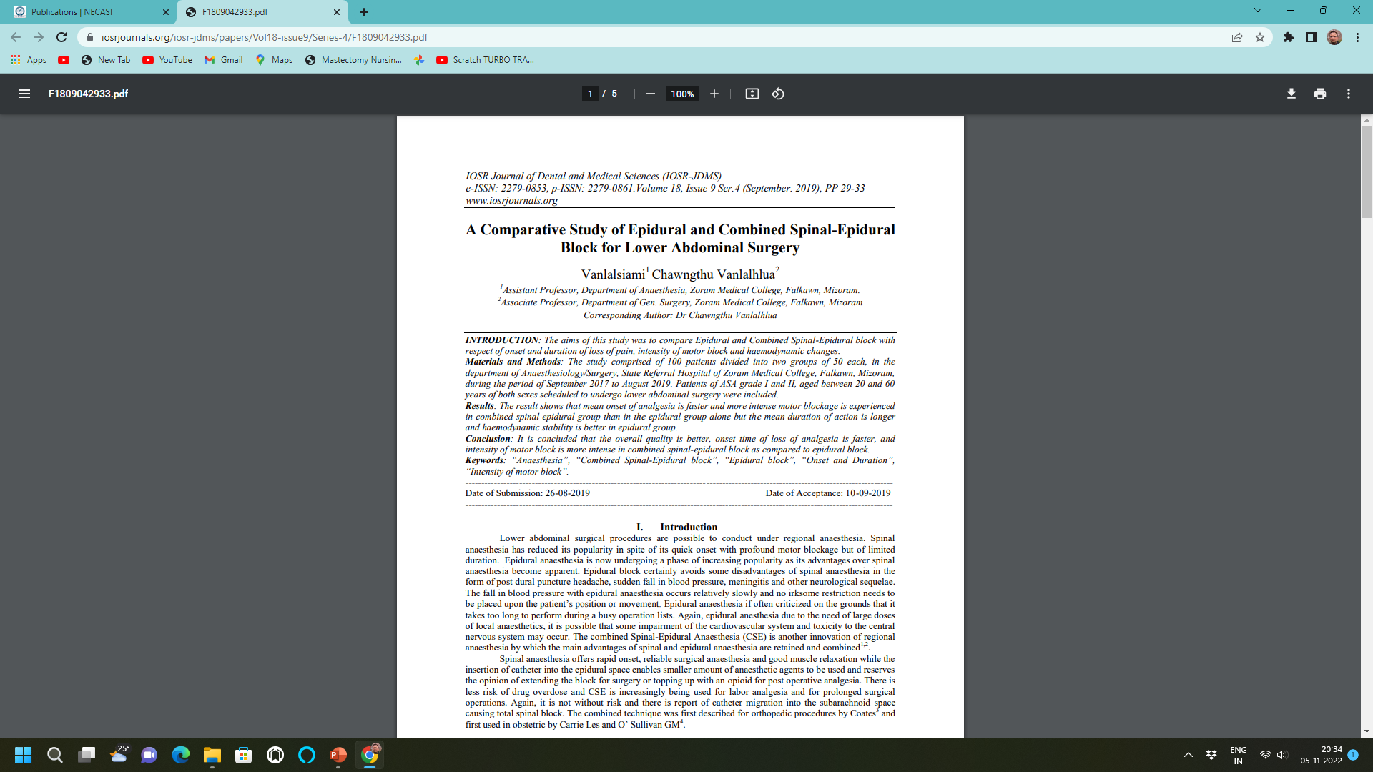
Paper Publication

Slide 10
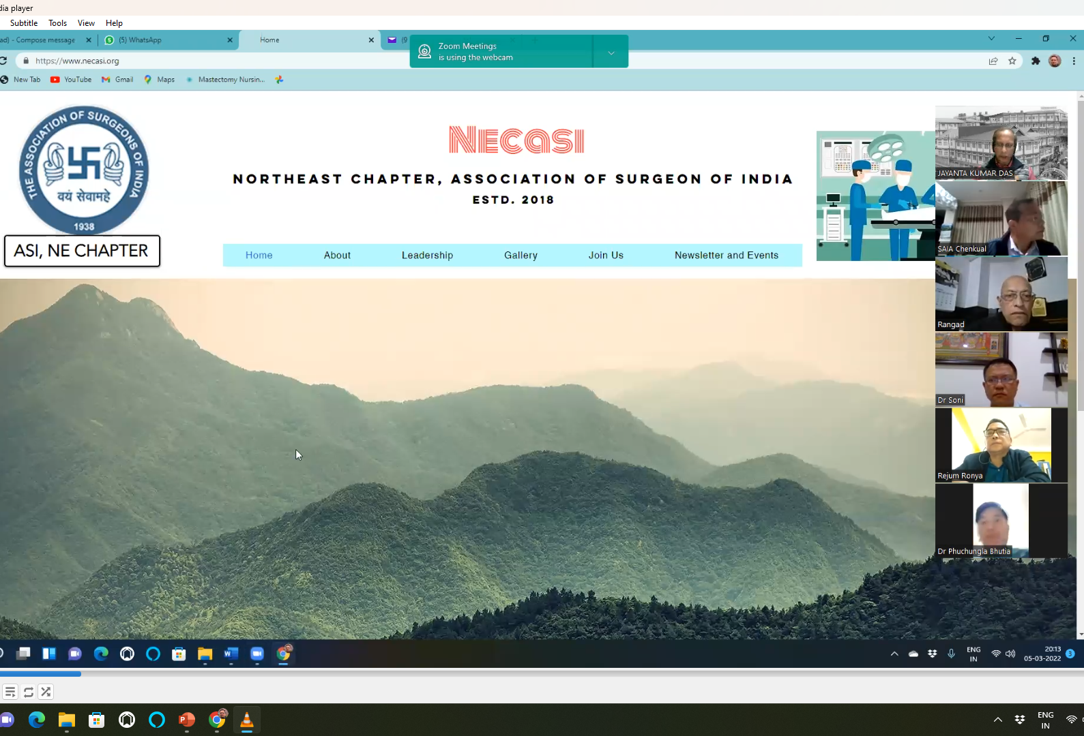
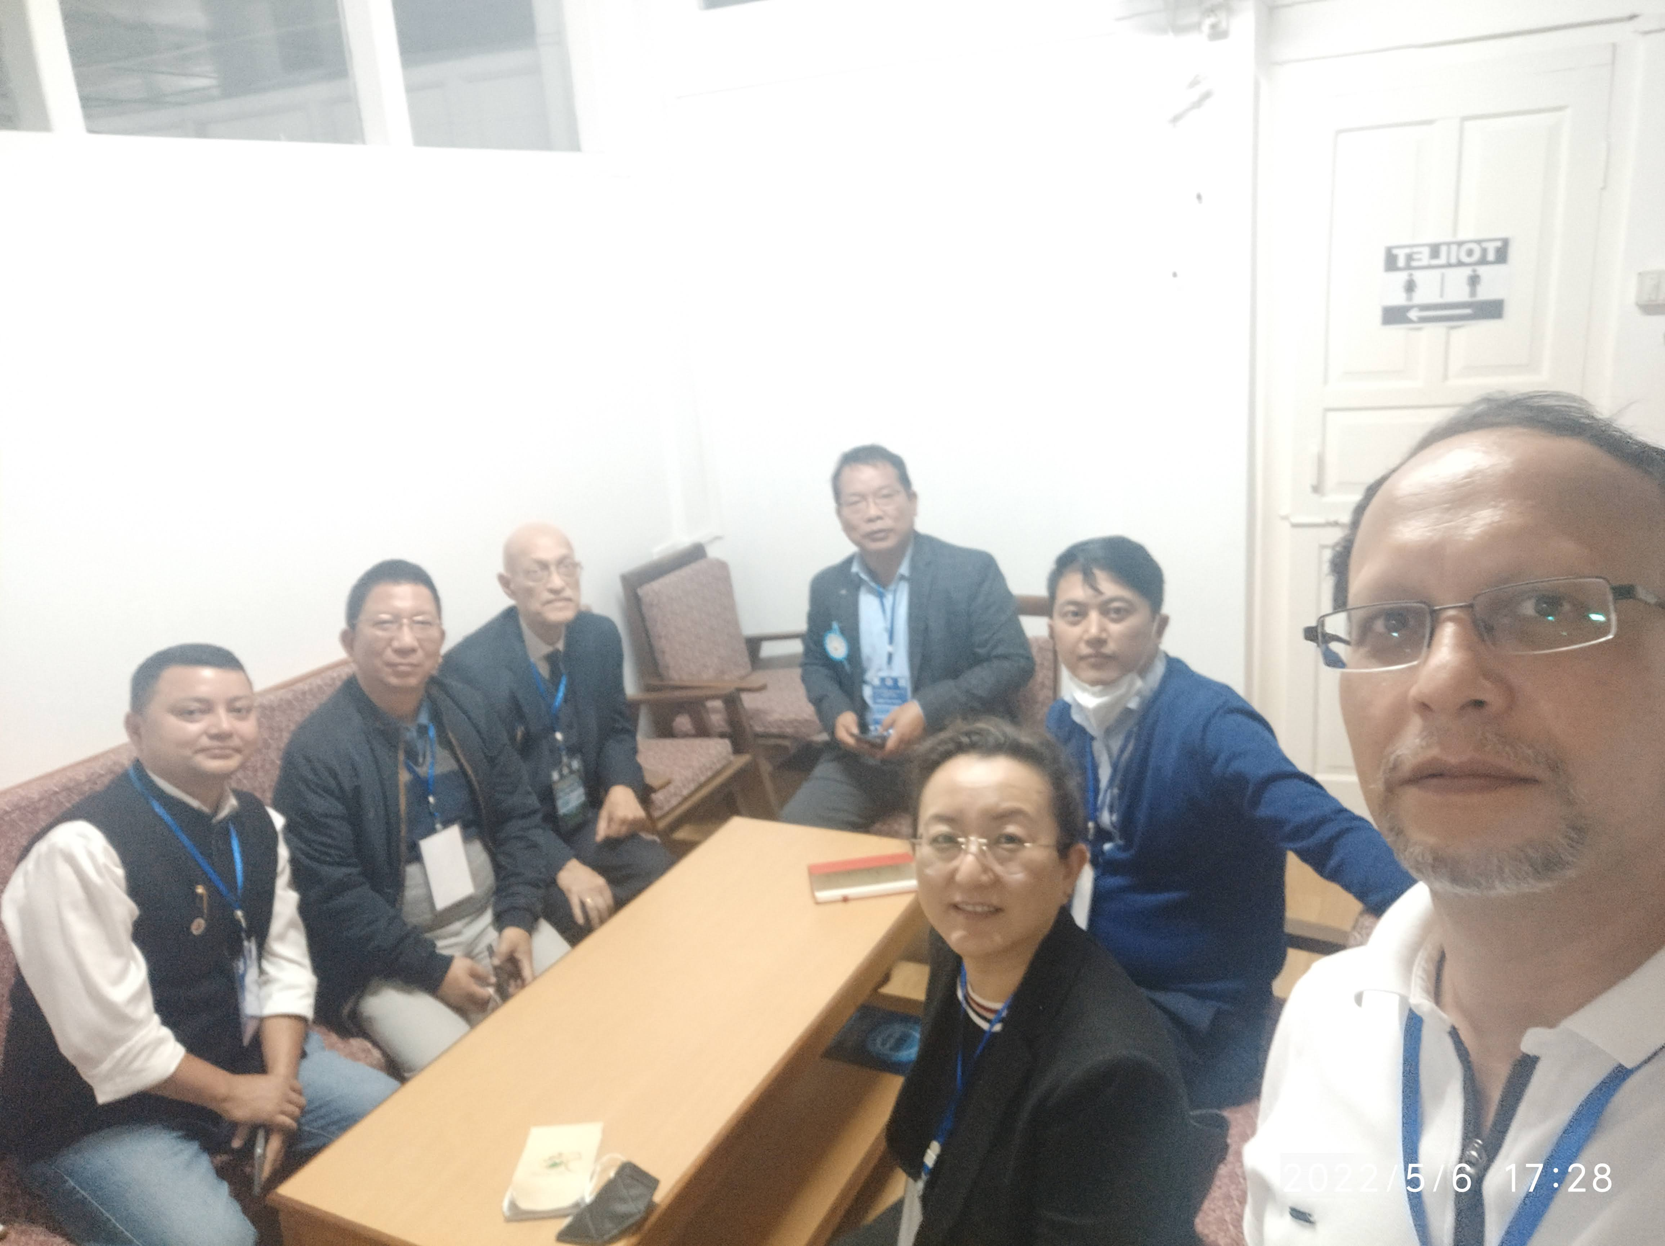
Regular EC meetings

Slide 11
Future Plan:
Encourage members to join our mother association- ASI
More FREE SURGICAL HEALTH camps
Regional level workshops
Paper publications

Slide 12
15TH November, 2022……..

Slide 13
THANK YOU
Long Live NECASI
Long Live ASI

